Slide 1


Transaction data insights
For Data from 2009 to 2011

Slide 2
Contents of this Presentation
Exploratory Data Analyses :
Understanding the Key Dimensions
Transaction History Deep Dive
Customer behaviour Dimension
Customer Reorder / Return / Loyalty
Geographical Dimension
Temporal Dimension
Product Dimension Deep Dive
Price
Revenue
Summary of Insights and Recommendations
Appendix 1 : Data Integrity
Incoming Data , Cleaning ,Checking , Assumptions
Appendix 2 : Future Imporvements
Appendix 3 : Code-Base Brief Overvierw

Slide 3
Understanding the Data Set
What are the Key Dimensions and Facts

Slide 4
The Data Set contains Transaction / Ledger details for a retail company
~1M records from Jan-2009 to Dec-2011
In essence the Data is at an Invoice-Item Level
The following Datapoints are available :
Invoice : ID , Date , Order Status
Product : ID , Quantity , Price , Description
Customer : ID , Country
There are significant Data Integrity issues , which have been detailed in Appendix 1 : Data Integrity

Slide 5
Transactions over Months
From Jan-2009 to Dec-2011

Slide 6

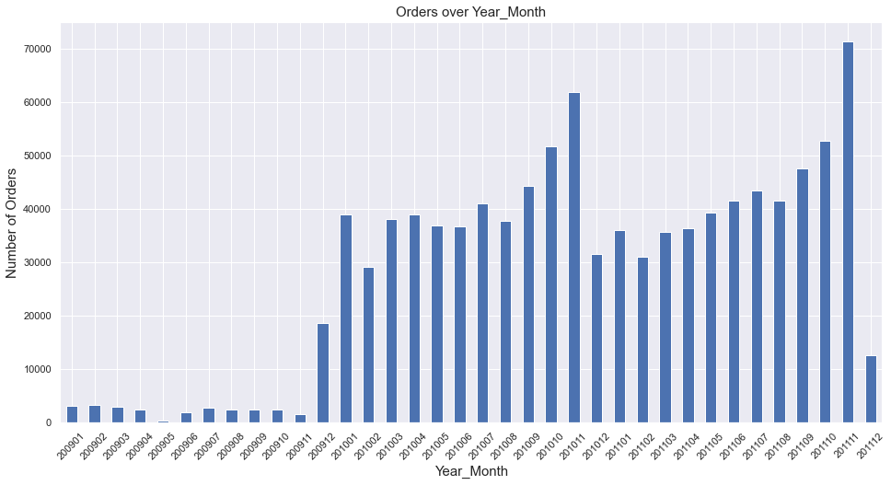



Transactions in 2009 have been very minimal . These Transactions are not uniformly distributed over all weeks These intermittent Transactions could be because of incomplete data or intermittent business operations Sales Pickup Near 2009 EOY , before the Christmas/NY period . A similar seasonal uplift in sales is again observed in 2010 and 2011 in the same Oct/Nov Time period . A consistent seasonal dip in Sales is observed in Dec after the yearly High , this Dip then recovers over the rest of the Year

Slide 7
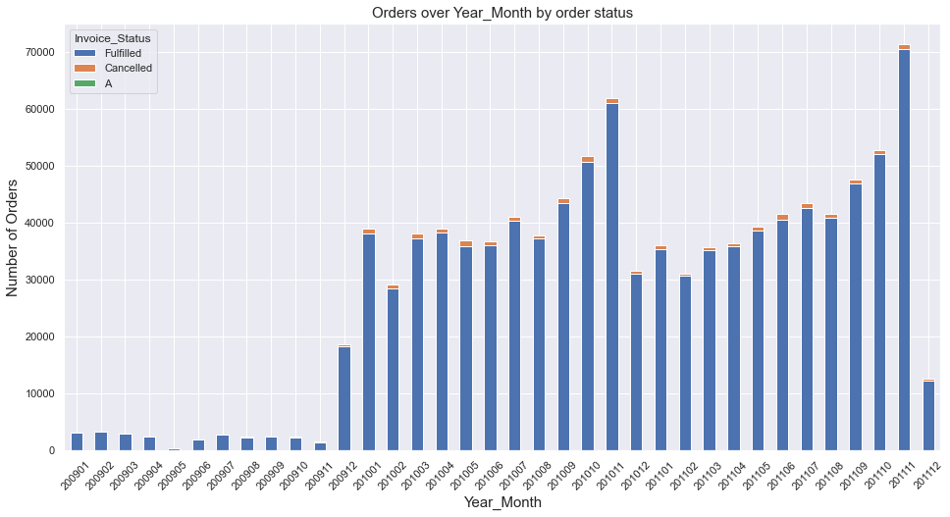
Order Cancellations are usually a minority at < 2% , Cancelled Orders also coincide a lot with the datapoints that have poor quality , this is detailed in the Appendix 1

Slide 8
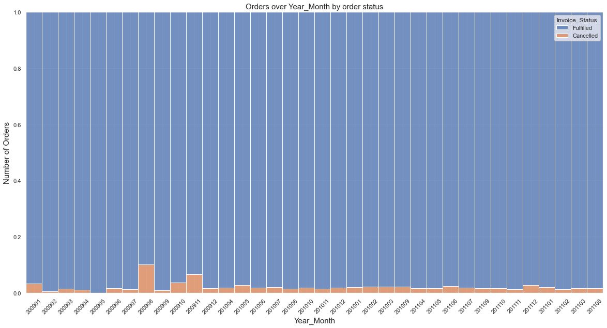
Order Cancellations ( Orange ) normalized share : The last time Cancelled Orders peaked was in 2009 Aug and Nov , the data is sparse there and it is difficult to conclude the reason for this life in Cancellation , without a deeper look and situational information

Slide 9
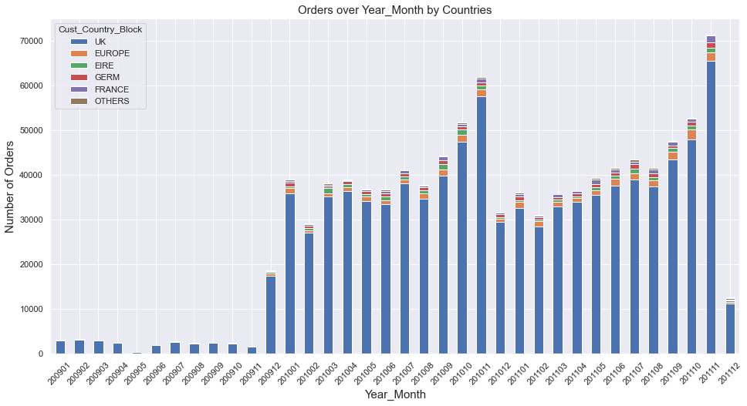
Majority of the Transactions ( 92 % ) and Sales Volume ( 85% , $16M ) is attributed to UK , UK is probably the Domestic Market for this company .

Slide 10
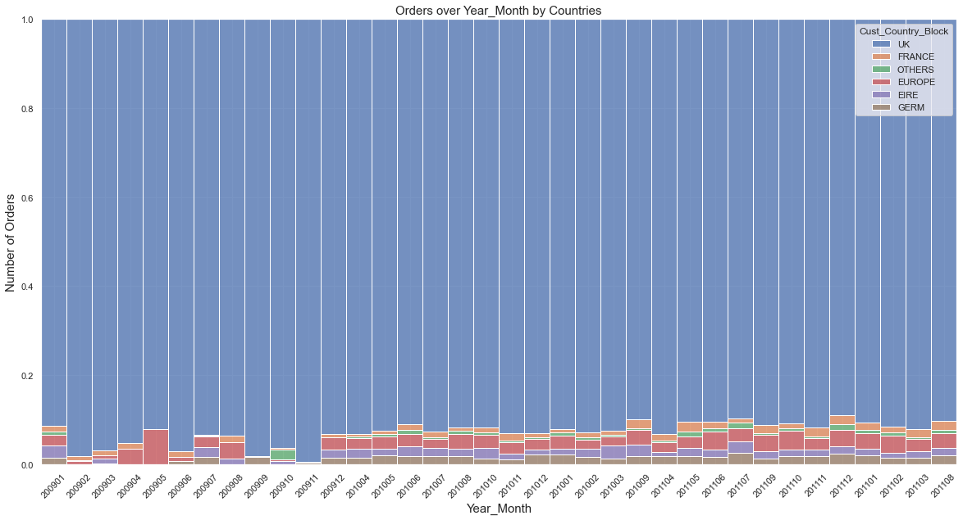
Domestic vs International Share has not changed much since 2009 , With France and the Rest of Europe having similar Trn. Volumes

Slide 11
Investigating Customer Loyalty Order –> ReOrder OR DropOut
re-ordering can be observed at 2 levels
one is a Customer Level - where a customer revisits the store ,
regardless of whether he buys the same items or not
the other scenario to study is when customers return to buy the same item multiple times

Slide 12
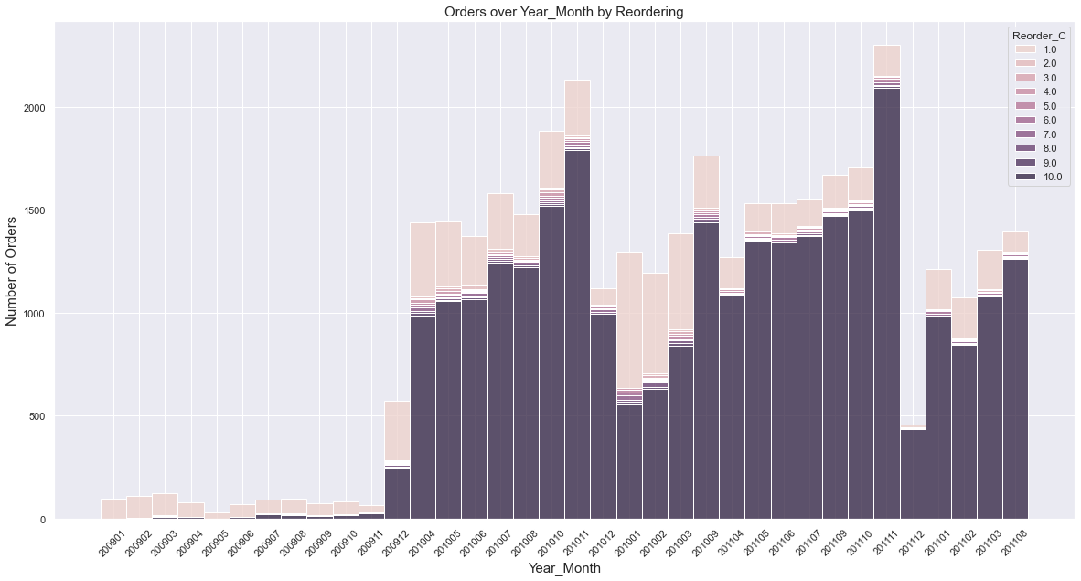
Case 1 : Customer Returns to buy different or even same Items Peach : New Customers ; Dark Purple : Customers who have placed >= 10 orders with company previously Majority of the Customers are Repeat Buyers , Which indicates that the company might be a B2B Supplier who has a small but loyal , recurring customer base

Slide 13
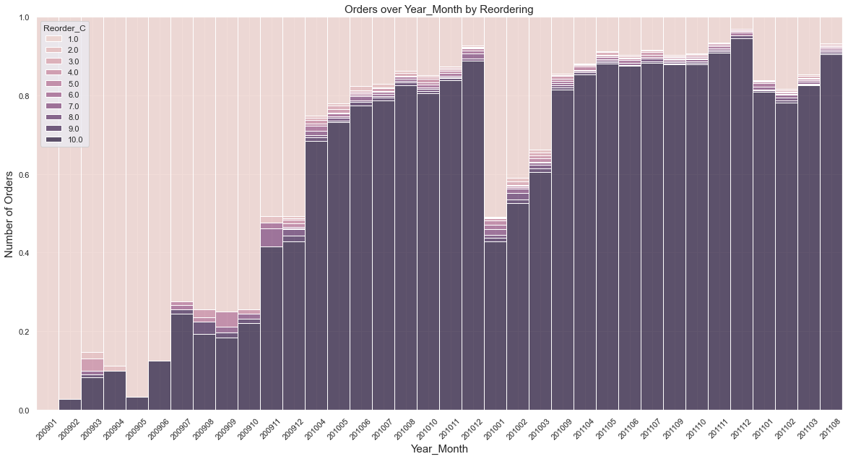
Case 1 : Normalized view : Share of Returning Customers Except New-Years and Christmas , the Customer Loyalty remains high , Dip near NY , might be due to influx of new customers gained from competitors , and some customers lost to competitors

Slide 14
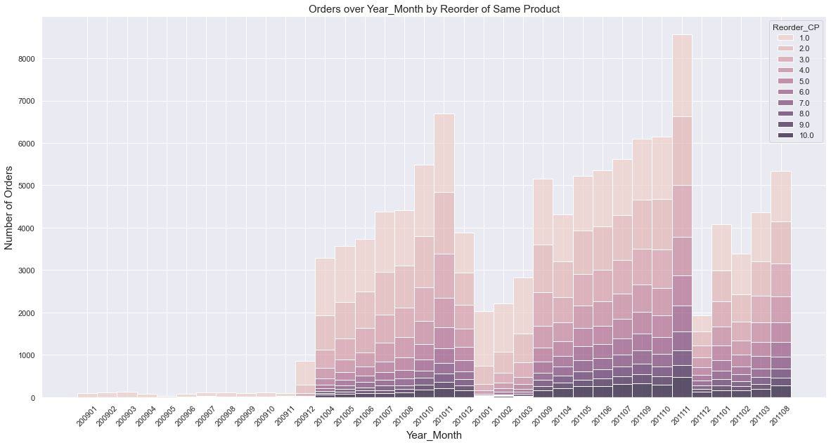
Case 2 : Customer Returns to buy the same Item again Peach : New Customers ; Dark Purple : Customers who have placed >= 10 orders with company previously Majority of the Customers are Repeat Buyers for the same Item , Which indicates that the company might be a selling an AYR/365 Item

Slide 15
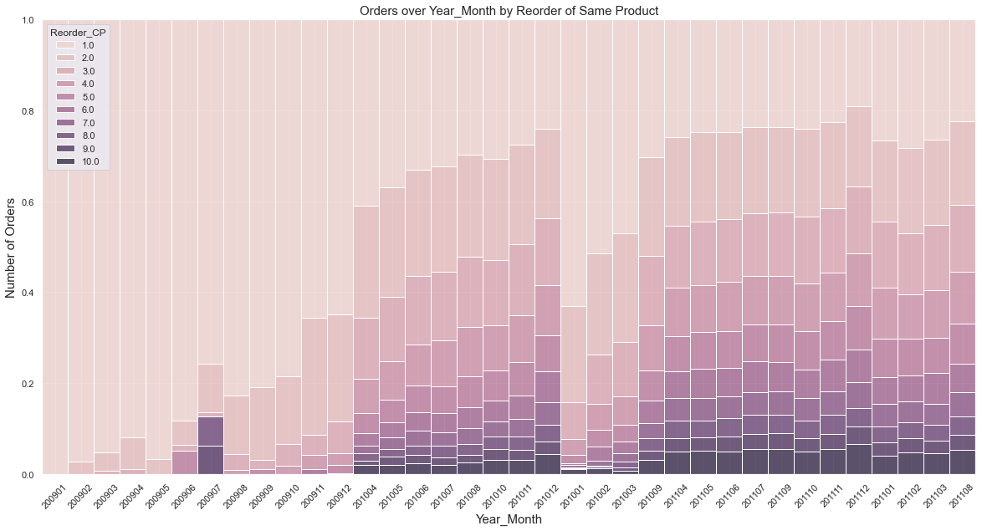
Case 2 : Customer Returns to buy the same Item again Except New-Years and Christmas , the Customer Loyalty remains high , Customer share of New vs. repeating Stabilize over time , indicating lesser customer churn

Slide 16
Product and Price Dimension

Slide 17
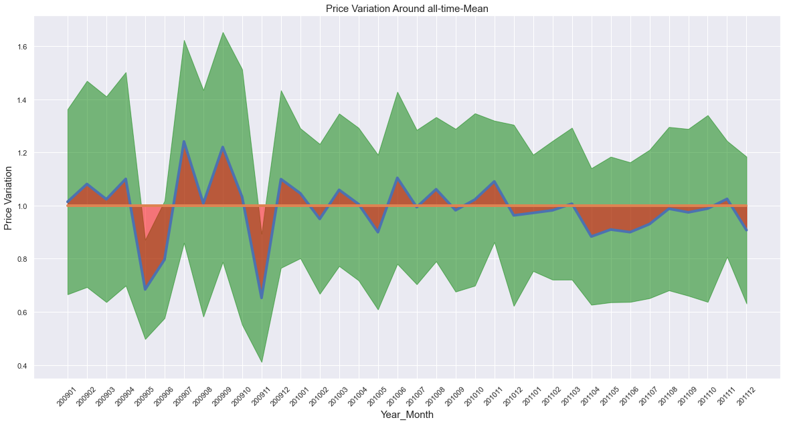
Mean-Normalized Price variation over Time : The Product Price has a trend to decrease over time , indicating Discounts . MarkDowns The Product Price was very Volatile in 2009 , this could be because of Unreliable Data and Intermittent Transactions Red : Difference from Historical Mean Price at Product level , Green : Standard Deviation

Slide 18
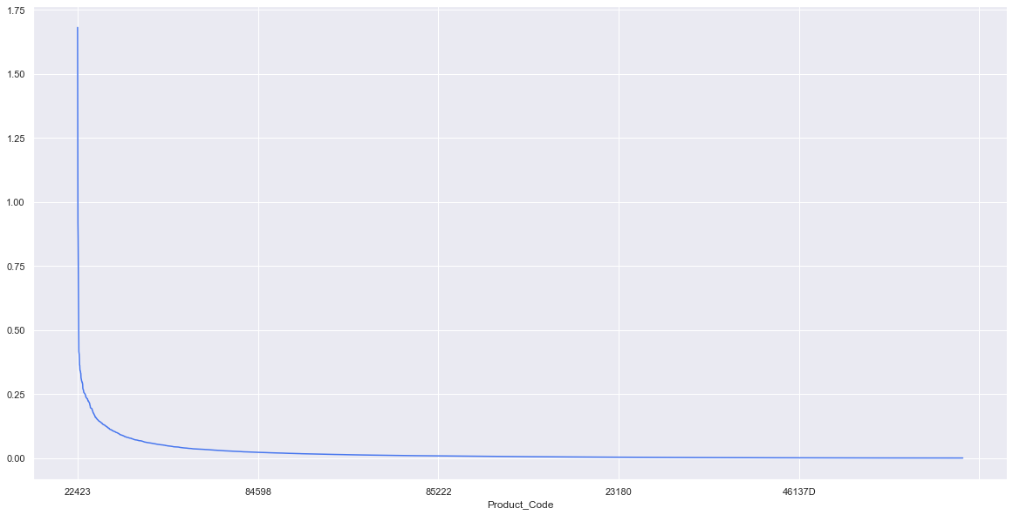
the top selling product only accounts for 1.6 % of the sales , which implies that the sales are distributed over a wide product line but even then , the sales pattern stills follows a sharp Pareto distribution , with a minority of SKUs responsible for majority of the sales
Product Code | Sales Share %
22423 | 1.68
85123A | 1.31
85099B | 0.92
23843 | 0.86
47566 | 0.75
84879 | 0.66
22086 | 0.60
23166 | 0.42
79321 | 0.41
22197 | 0.40

Slide 19
Transactions Volumes in Day and Week Levels

Slide 20
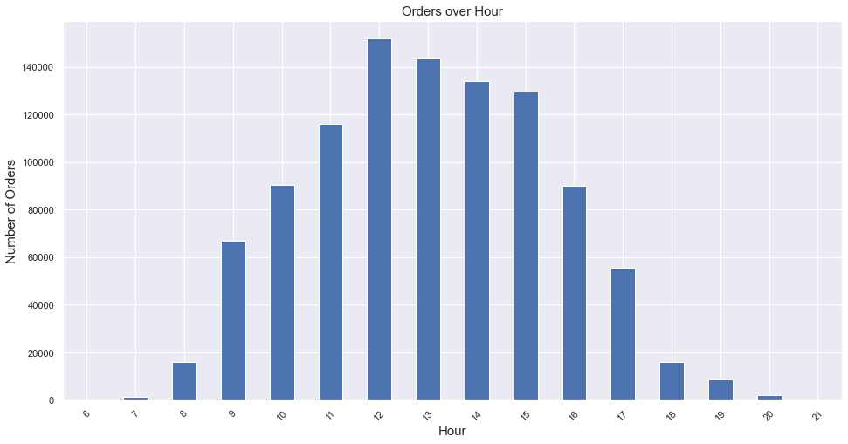
Orders Peak in the Working Hours , which might suggest that the company is an Industrial / B2B supplier , instead of a consumer retailer

Slide 21
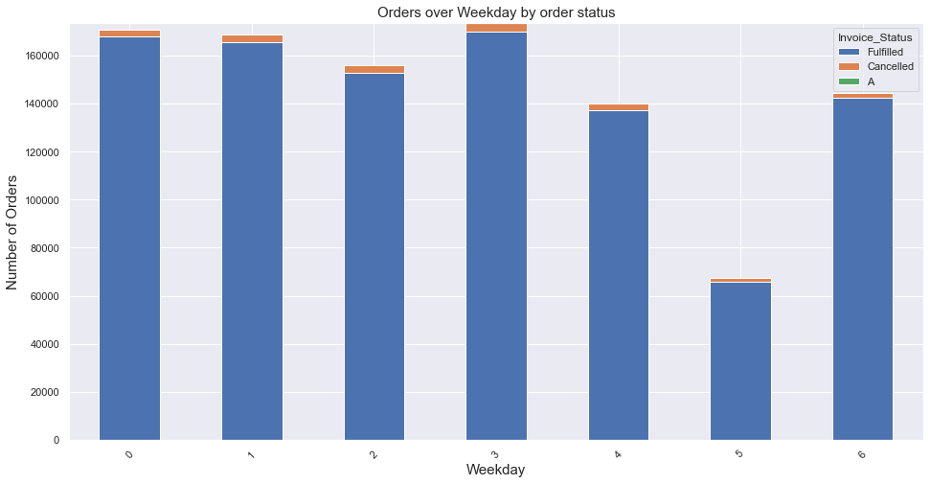
There are very Few Orders coming in on Saturdays , while Sunday Seems to be an active Day It is possible that the company could have an Online Channel too for accepting Orders on Non-Working days

Slide 22
Appendix 1
Data INTEGRITY DEEP-DIVE

Slide 23
Steps In the Data Pipeline
Export Data from Incoming Excel to Create CSV dumps
Append 2 CSVs to create a Pandas DF
Remove Absolute Duplicates ( All rows are same ).
Establish Logical Level of the Data
Data is supposed to be at Invoice-Item Level
Rename Columns for Readability and Ease-of-use
Remove Cancellation encoding from Invoice_ID as a separate flag column
Analyse Product Code for Anomalies , and create a Flag to mark these
( DeepDive in next slides )
Type setting of Columns

Slide 24
Anomalous Data Points in Columns
Analyse Negative Values in Product_Qty
86% of Negatives explained by Order Cancellations (maybe to adjust inventory count )
Remaining Explained By iNstances where Cust_ID was NULL
Took these Product_Desc as added them to the Adjustment Codes List for the Mask Flag
Analyse Negative Values in Product_Price
Negative Prices are found only During yearly Stock Adjustments , They Have Product Code ‘B’
Special Product_Desc codes explain such discrepancies , added them to the Codes List
Handling Null values in Cust_ID :
Since each Invoice_ID is uniquely mapped to only one Cust_ID
Used Invoive_ID – Cust_ID map to fill in missing Cust_IDs
But this was unsuccessful in filling in , as these missing Cust_IDs were in a block of time

Slide 25
Fixing the Data-Level
Analysing Errors in Logical Data Level
Data is supposed to be at Invoice-Item Level
But on doing Groupby-Count there are 2.2% Instances which violates this level ( i.e. have count > 1)
This was NOT because of there being Duplicate entries for Cancelled Orders
( i.e. one entry for Original order , then one entry when order was Cancelled , This was NOT the case)
There were Multiple Rows with Different Prices and Qtys for the same Invoice-Item Level
Possibly to calculate the same Order-Item at different prices for multiple Qtys
There were very few instances of Product_Desc column showing level discrepancies,
Since that column was not relevant to any analyses , we can ignore those
Fixing the Level to Inovice-Item :
All the columns were Aggregated appropriately ( Sale : Sum , Qty : Sum , Price : Mean , Rest : Mode )

Slide 26
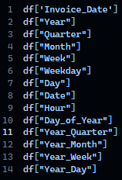
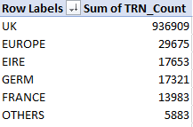
Creation of Auxiliary Features for Analysis
Time Dimension Features for Group Bys :
created from TimeStamp column : Invoice_Date
Levels : Year , Quarter , Month , Week , WeekDay , Day , Hour
Country column simplification
There were 43 distinct countries ,
But ‘UK’ Accounts for 93% of Transactions
So grouped Countries into based on Sales and Geography
Exported Final data for Consumption in Analysis

Slide 27
Appendix 2
Further Improvements AND NEXT STEPS

Slide 28
Things to try out
Rate of Sale Analysis :
Which item sells fast , which Items sell slow , Their Contribution to Sales
Order Cancellation RCA
What circumstances lead to cancelled orders
RFM Analysis : Recency , Frequency , Money
Customer Segmentation ( Unsupervised Clustering )
WordCloud , NLP embeddings

Slide 29
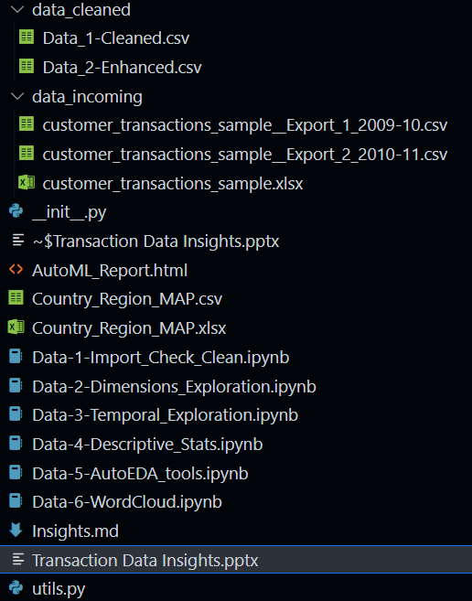
Appendix 3
Brief Code Base Over-View

Slide 30
Thank You
Saif Raja
7775029864
saifuddin.raja24@gmail.com

